Slide 1


Nuno Ferreira
August 2024

Slide 2

Outline
Executive Summary
Introduction
Methodology
Results
Conclusion
Appendix

Slide 3
Executive Summary
Summary of methodologies
Data collection (using API’s and web scraping)
Data wrangling
EDA with SQL
EDA with data visualization
Building an interactive map with Folium
Building a Dashboard with Plotly Dash
Predictive analysis (Classification)
Summary of all results
Exploratory data analysis results
Interactive analytics demo in screenshots
Predictive analysis results

Slide 4
Introduction
Project background and context
In this presentation, we aim to predict the successful landing of the Falcon 9 first stage.
SpaceX advertises Falcon 9 rocket launches at a cost of 62 million dollars, significantly lower than the industry average of 165 million dollars offered by other providers.
The cost-effectiveness is primarily attributed to SpaceX's ability to reuse the first stage. By accurately predicting the success of the first stage landing, we can determine the potential cost of a launch.
This information can be invaluable for companies looking to bid against SpaceX in the competitive rocket launch market.
Problems you want to find answers
Identify the correlation between rocket launch success and various launch characteristics such as launch site and rocket type.
Identify the optimal predictive model for determining rocket landing outcome.

Slide 5

Section 1

Slide 6
Methodology
Executive Summary
Data collection methodology:
SpaceX API and web scraping to collect Falcon 9 historical launch records from a Wikipedia page titled List of Falcon 9 and Falcon Heavy launches
Perform data wrangling
Augmented data with a Boolean feature for the landing outcome
Perform exploratory data analysis (EDA) using SQL and visualization
Perform interactive visual analytics using Folium and Plotly Dash
Perform predictive analysis using classification models
Determine optimal hyperparameter for SVM, Classification Trees and Logistic Regression models

Slide 7
Data Collection
Describe how data sets were collected.
You need to present your data collection process use key phrases and flowcharts

Slide 8
Falcon 9
Data Collection – SpaceX API
Present your data collection with SpaceX REST calls using key phrases and flowcharts
Add the GitHub URL of the completed SpaceX API calls notebook (must include completed code cell and outcome cell), as an external reference and peer-review purpose
Place your flowchart of SpaceX API calls here

Slide 9
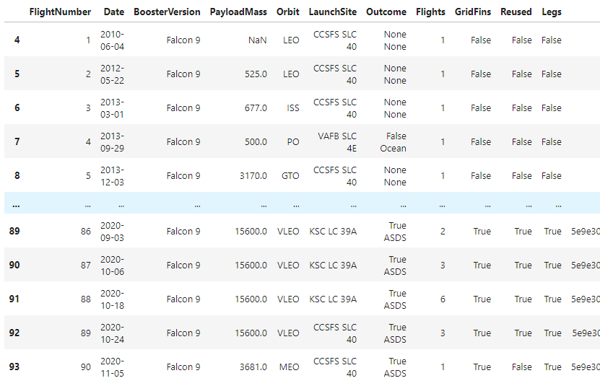
Data Collection – SpaceX API
Request and parse the SpaceX launch data
GET request to https://api.spacexdata.com/v4/launches/past
Convert result into a Pandas dataframe using pd.json_normalize()
Request and parse detailed launch information
Using the launch ID’s get detailed data for each rocket launch. For each feature create a list.
Finally create a new dataframe with the combined information
Data Wrangling -
filter data
Filter on “Falcon 9” launches
Partial picture of the final dataframe
Data Wrangling – identify and deal with missing values.
Replace missing “Payload Mass” values with its mean
Save dataframe to CSV file.
https://github.com/[...]spacex-data-collection-api.ipynb

Slide 10
Data Collection - Scraping
Present your web scraping process using key phrases and flowcharts
Add the GitHub URL of the completed web scraping notebook, as an external reference and peer-review purpose
Place your flowchart of web scraping here

Slide 11
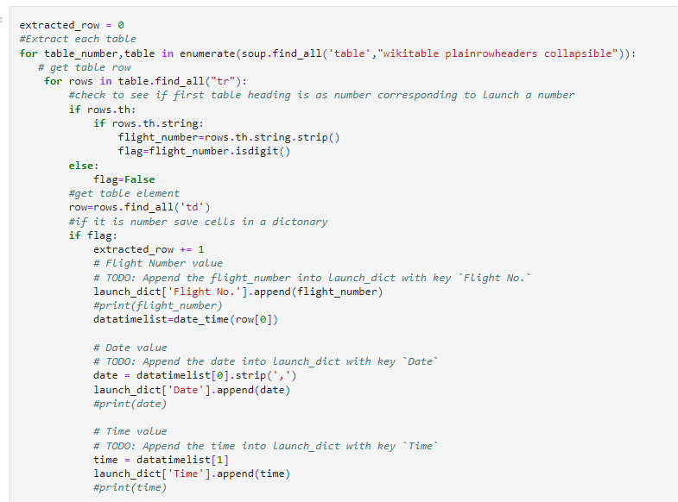
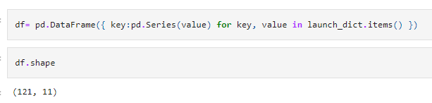
Data Collection - Scraping
Request the Falcon9 Launch Wiki page from its URL
Extract a Falcon 9 launch records HTML table from Wikipedia
Extract all column/variable names from the HTML table header
(starting from the third table)
Create an empty dictionary with keys from the extracted column names
Partial picture of the parsing process using a launch_dict dictionary
Parse the table and convert it into a Pandas data frame
Create a data frame by parsing the launch HTML tables stored in the dictionary launch_dict
Picture of the final dataframe shape
Save dataframe to CSV file.
https://github.com/[...]labs-webscraping.ipynb
11

Slide 12
Data Wrangling
Describe how data were processed
You need to present your data wrangling process using key phrases and flowcharts
Add the GitHub URL of your completed data wrangling related notebooks, as an external reference and peer-review purpose
https://github.com/[...] spacex-Data%20wrangling.ipynb

Slide 13
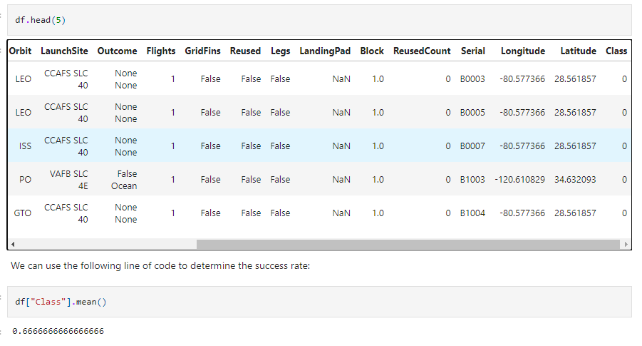
Data Wrangling
Data Analysis
Identify missing values in each attribute
Identify numerical and categorical columns
Calculate the number of launches on each site
Calculate the number and occurrence of each orbit
Partial picture of the final data frame with an additional outcome label named class
Calculate the number and occurrence of mission outcome of the orbits
Create a landing outcome label
Create a landing outcome label from Outcome column, a bad outcome=0, otherwise 1
Save dataframe to CSV file
https://github.com/[...] spacex-Data%20wrangling.ipynb
13
13

Slide 14
EDA with SQL
Using bullet point format, summarize the SQL queries you performed
Add the GitHub URL of your completed EDA with SQL notebook, as an external reference and peer-review purpose

Slide 15
EDA with SQL
https://github.com/[...]eda-sql-coursera_sqllite.ipynb
Summarize the SQL queries you performed:
Names of unique launch sites
5 records where launch sites begin with the string 'CCA’
Total payload mass carried by boosters launched by ‘NASA (CRS)’
Average payload mass carried by booster version ‘F9 v1.1’
Date when the first successful landing outcome in ground pad was achieved.
Names of the boosters which have success in drone ship and have payload mass greater than 4000 but less than 6000
Total number of successful and failure mission outcomes
Names of the booster versions which have carried the maximum payload mass.
Records which will display the month names, failure landing outcomes in drone ship, booster versions, launch site for the months in year 2015
Rank the count of landing outcomes (such as Failure (drone ship) or Success (ground pad) between the date 2010-06-04 and 2017-03-20, in descending order.

Slide 16
EDA with Data Visualization
Summarize what charts were plotted and why you used those charts
Add the GitHub URL of your completed EDA with data visualization notebook, as an external reference and peer-review purpose

Slide 17
EDA with Data Visualization
https://github.com/[...] edadataviz.ipynb
Summarize what charts were plotted and why you used those charts:
Visualize how the Flight Number (indicating the continuous launch attempts.) and Payload variables would affect the launch outcome. Plot a scatter point chart ‘Flight Number’ vs. ‘Payload Mass’ and overlay the outcome of the launch.
Visualize the relationship between Flight Number and Launch Site. Plot a scatter point chart ‘Flight Number’ vs. ‘Launch Site’, and hue to be the ‘class’ value (overlay of the outcome of the launch)
Visualize the relationship between Payload Mass and Launch Site. Plot a scatter point chart ‘Pay Load Mass (kg)’ vs. ‘Launch Site’, and hue to be the ‘class’ value (overlay of the outcome of the launch)
Visualize the relationship between success rate of each orbit type. Plot a bar chart ‘Orbit’ vs. ‘Class’ mean, grouped by ‘Orbit’
Visualize the relationship between Flight Number and Orbit type. Plot a scatter point chart ‘Flight Number’ vs. ‘Orbit’, and hue to be the class value
Visualize the relationship between Payload Mass and Orbit type. Plot a scatter point chart ‘Payload Mass’ vs. ‘Orbit’, and hue to be the class value
Visualize the launch success yearly trend. Plot a line chart ‘Year’ vs ‘Class’ sum, grouped by ‘Year’

Slide 18
Build an Interactive Map with Folium
Summarize what map objects such as markers, circles, lines, etc. you created and added to a folium map
Explain why you added those objects
Add the GitHub URL of your completed interactive map with Folium map, as an external reference and peer-review purpose

Slide 19
Build an Interactive Map with Folium
Summarize what map objects such as markers, circles, lines, etc. you created and added to a folium map
Explain why you added those objects
Add the GitHub URL of your completed interactive map with Folium map, as an external reference and peer-review purpose

Slide 20
Build a Dashboard with Plotly Dash
Summarize what plots/graphs and interactions you have added to a dashboard
Explain why you added those plots and interactions
Add the GitHub URL of your completed Plotly Dash lab, as an external reference and peer-review purpose

Slide 21
Predictive Analysis (Classification)
Summarize how you built, evaluated, improved, and found the best performing classification model
You need present your model development process using key phrases and flowchart
Add the GitHub URL of your completed predictive analysis lab, as an external reference and peer-review purpose

Slide 22
Results
Exploratory data analysis results
Interactive analytics demo in screenshots
Predictive analysis results

Slide 23

Section 2

Slide 24
Flight Number vs. Launch Site
Show a scatter plot of Flight Number vs. Launch Site
Show the screenshot of the scatter plot with explanations

Slide 25
Payload vs. Launch Site
Show a scatter plot of Payload vs. Launch Site
Show the screenshot of the scatter plot with explanations

Slide 26
Success Rate vs. Orbit Type
Show a bar chart for the success rate of each orbit type
Show the screenshot of the scatter plot with explanations

Slide 27
Flight Number vs. Orbit Type
Show a scatter point of Flight number vs. Orbit type
Show the screenshot of the scatter plot with explanations

Slide 28
Payload vs. Orbit Type
Show a scatter point of payload vs. orbit type
Show the screenshot of the scatter plot with explanations

Slide 29
Launch Success Yearly Trend
Show a line chart of yearly average success rate
Show the screenshot of the scatter plot with explanations

Slide 30
All Launch Site Names
Find the names of the unique launch sites
Present your query result with a short explanation here

Slide 31
Launch Site Names Begin with 'CCA'
Find 5 records where launch sites begin with `CCA`
Present your query result with a short explanation here

Slide 32
Total Payload Mass
Calculate the total payload carried by boosters from NASA
Present your query result with a short explanation here

Slide 33
Average Payload Mass by F9 v1.1
Calculate the average payload mass carried by booster version F9 v1.1
Present your query result with a short explanation here

Slide 34
First Successful Ground Landing Date
Find the dates of the first successful landing outcome on ground pad
Present your query result with a short explanation here

Slide 35
Successful Drone Ship Landing with Payload between 4000 and 6000
List the names of boosters which have successfully landed on drone ship and had payload mass greater than 4000 but less than 6000
Present your query result with a short explanation here

Slide 36
Total Number of Successful and Failure Mission Outcomes
Calculate the total number of successful and failure mission outcomes
Present your query result with a short explanation here

Slide 37
Boosters Carried Maximum Payload
List the names of the booster which have carried the maximum payload mass
Present your query result with a short explanation here

Slide 38
2015 Launch Records
List the failed landing_outcomes in drone ship, their booster versions, and launch site names for in year 2015
Present your query result with a short explanation here

Slide 39
Rank Landing Outcomes Between 2010-06-04 and 2017-03-20
Rank the count of landing outcomes (such as Failure (drone ship) or Success (ground pad)) between the date 2010-06-04 and 2017-03-20, in descending order
Present your query result with a short explanation here

Slide 40

Section 3

Slide 41
<Folium Map Screenshot 1>
Replace <Folium map screenshot 1> title with an appropriate title
Explore the generated folium map and make a proper screenshot to include all launch sites’ location markers on a global map
Explain the important elements and findings on the screenshot

Slide 42
<Folium Map Screenshot 2>
Replace <Folium map screenshot 2> title with an appropriate title
Explore the folium map and make a proper screenshot to show the color-labeled launch outcomes on the map
Explain the important elements and findings on the screenshot

Slide 43
<Folium Map Screenshot 3>
Replace <Folium map screenshot 3> title with an appropriate title
Explore the generated folium map and show the screenshot of a selected launch site to its proximities such as railway, highway, coastline, with distance calculated and displayed
Explain the important elements and findings on the screenshot

Slide 44

Section 4

Slide 45
<Dashboard Screenshot 1>
Replace <Dashboard screenshot 1> title with an appropriate title
Show the screenshot of launch success count for all sites, in a piechart
Explain the important elements and findings on the screenshot

Slide 46
<Dashboard Screenshot 2>
Replace <Dashboard screenshot 2> title with an appropriate title
Show the screenshot of the piechart for the launch site with highest launch success ratio
Explain the important elements and findings on the screenshot

Slide 47
<Dashboard Screenshot 3>
Replace <Dashboard screenshot 3> title with an appropriate title
Show screenshots of Payload vs. Launch Outcome scatter plot for all sites, with different payload selected in the range slider
Explain the important elements and findings on the screenshot, such as which payload range or booster version have the largest success rate, etc.

Slide 48

Section 5

Slide 49
Classification Accuracy
Visualize the built model accuracy for all built classification models, in a bar chart
Find which model has the highest classification accuracy

Slide 50
Confusion Matrix
Show the confusion matrix of the best performing model with an explanation

Slide 51
Conclusions
Point 1
Point 2
Point 3
Point 4
…

Slide 52
Appendix
Include any relevant assets like Python code snippets, SQL queries, charts, Notebook outputs, or data sets that you may have created during this project

Slide 53


